Slide 1


ArcFace
GNR638 Project

Slide 2
Initial Stages
Problem Statement
Existing Techniques
Search for Papers
Arcface

Slide 3
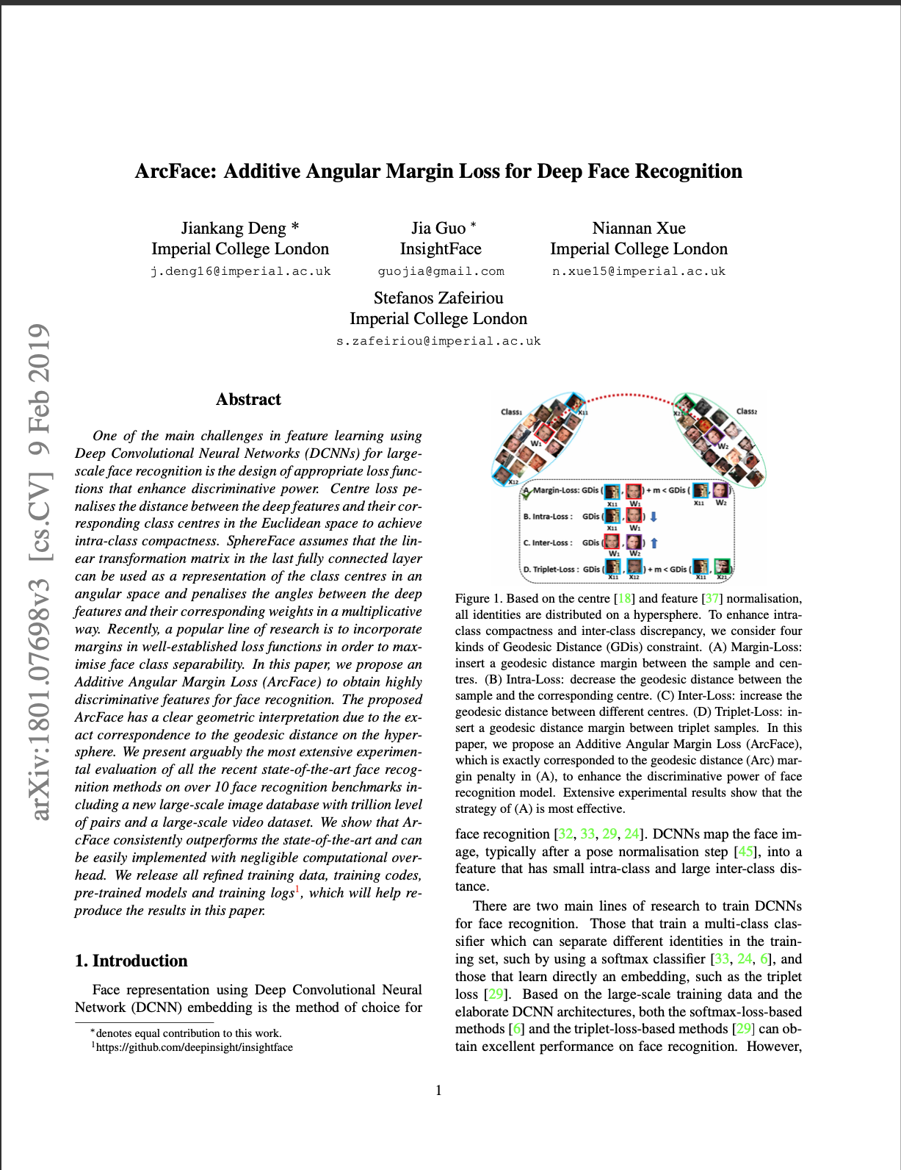
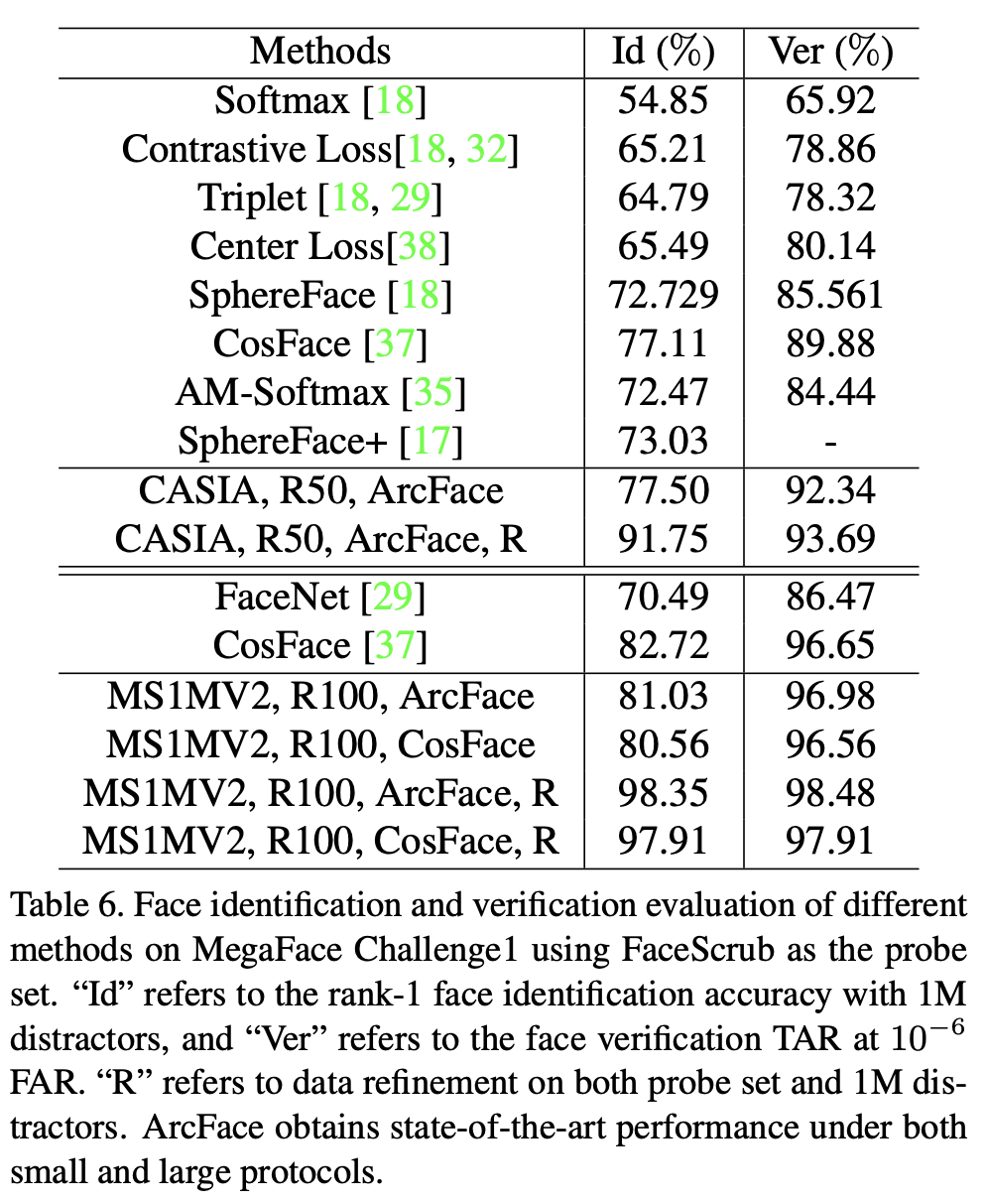
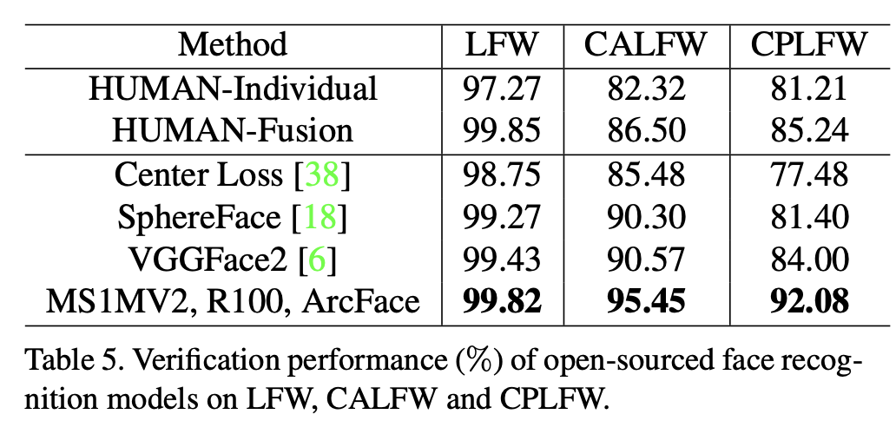
Arcface Paper & Performance
ArcFace: Additive Angular Margin Loss for Deep Face Recognition

Slide 4

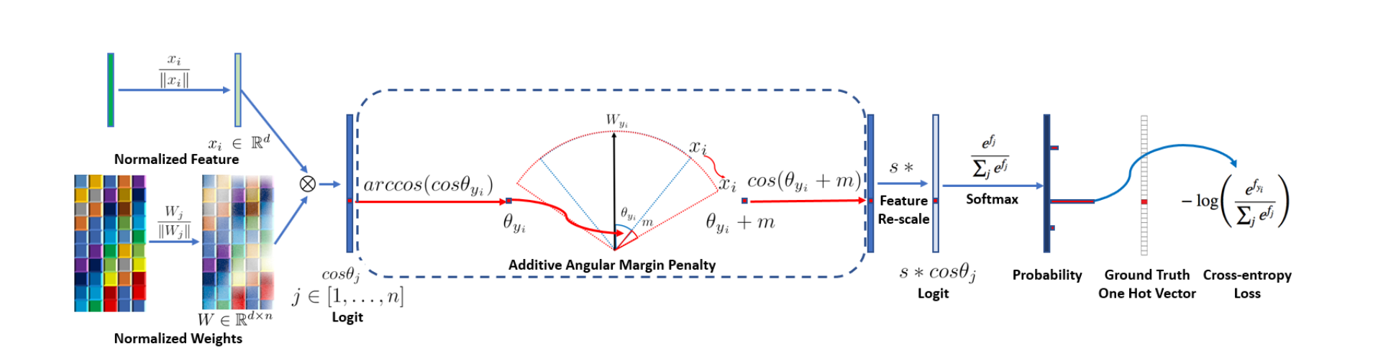

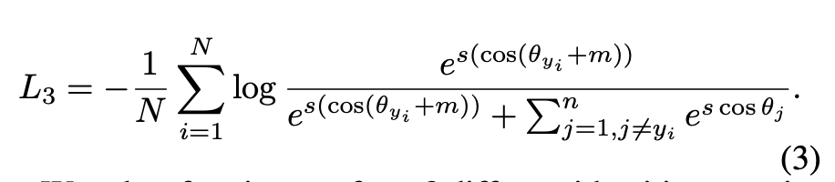
Arcface Loss

Slide 5
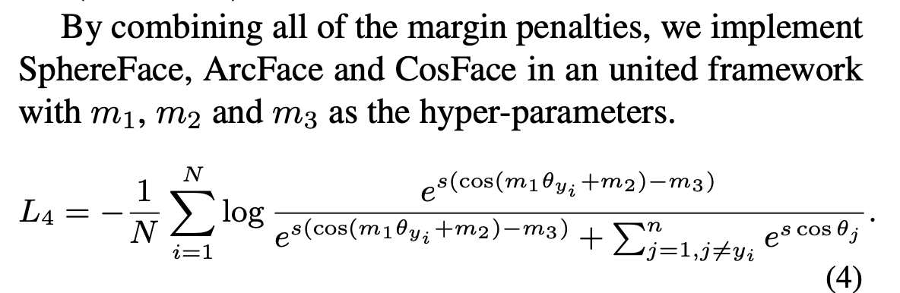
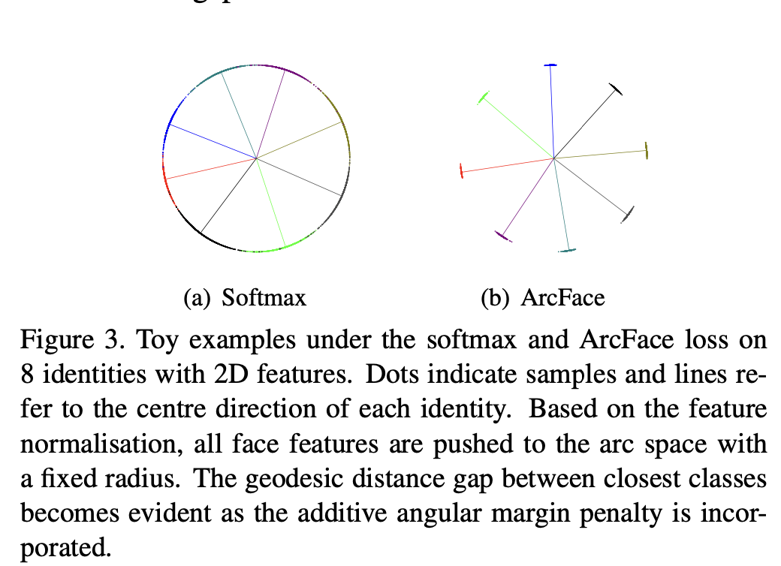
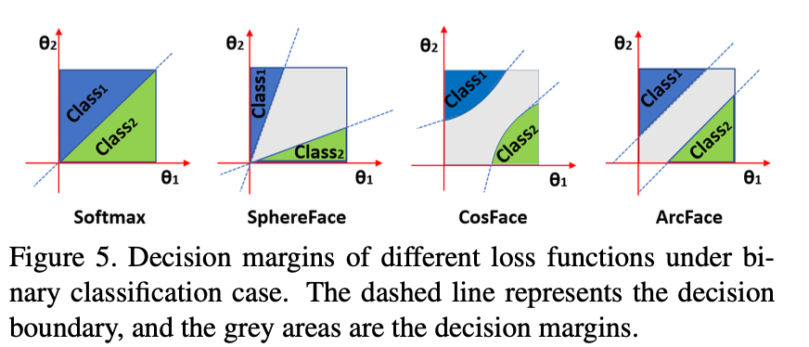
Comparison

Slide 6
Training 1
Dataset: Preprocessed LFW dataset
arccos: Method suggested in paper
Optimizer: Adam
Custom Training Loop
Saving formats

Slide 7
Training 2
Dataset: Preprocessed LFW dataset
Cos: Method seen in third party implementations
Optimizer: SGD

Slide 8
Training 3
Dataset: Casia Webface dataset (0.5 Million images, 10K+ people)
Cos: Method seen in third party implementations
Optimizer: SGD
Status: Failed

Slide 9
VISUALIZATION & INFERENCE

Slide 10
The Best Distance Metric
Dot product Distance
Normalized Embeddings' Dot product Distance
Cosine Distance
Normalized Embeddings' Cosine Distance
Euclidean Distance
Normalized Embeddings' Euclidean Distance

Slide 11
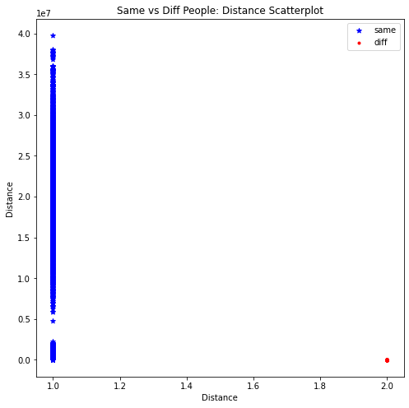
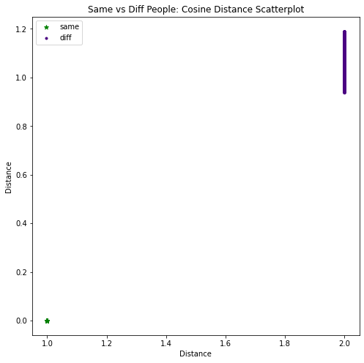
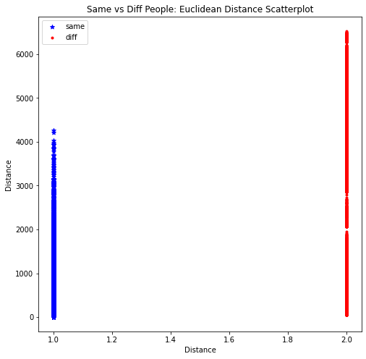
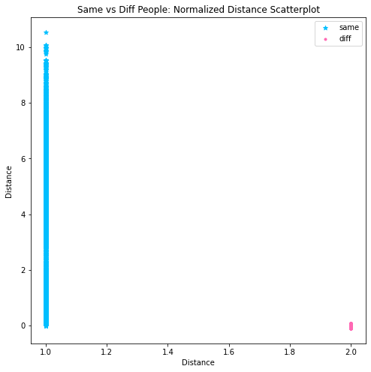
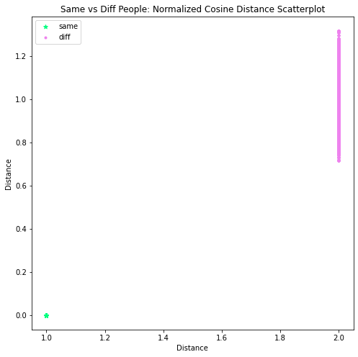
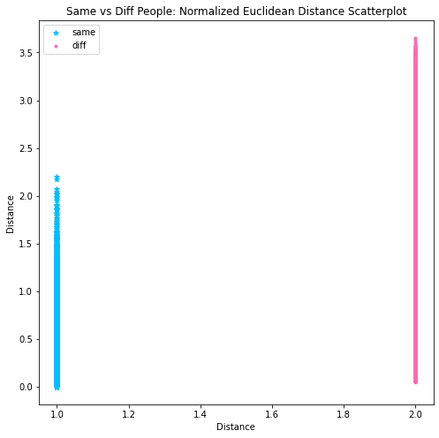

Slide 12
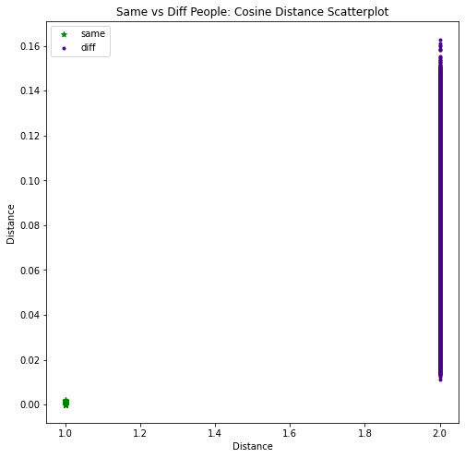
The Better Optimizer
Adam
SGD

Slide 13
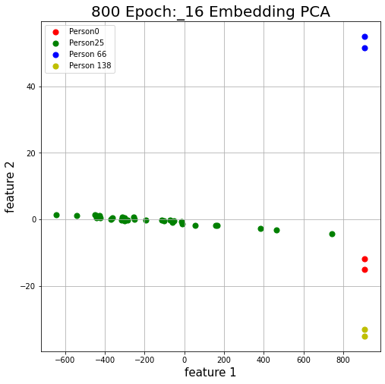
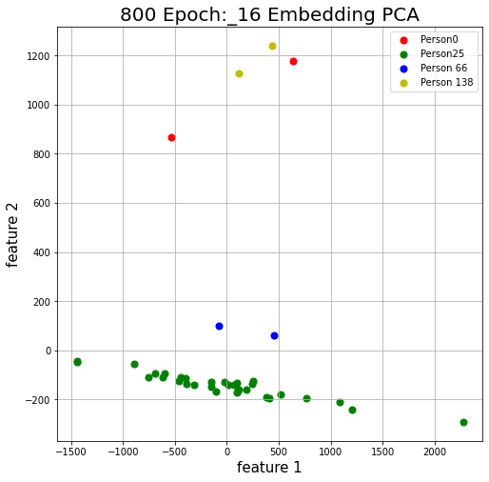
The Better Optimizer
Adam
SGD

Slide 14
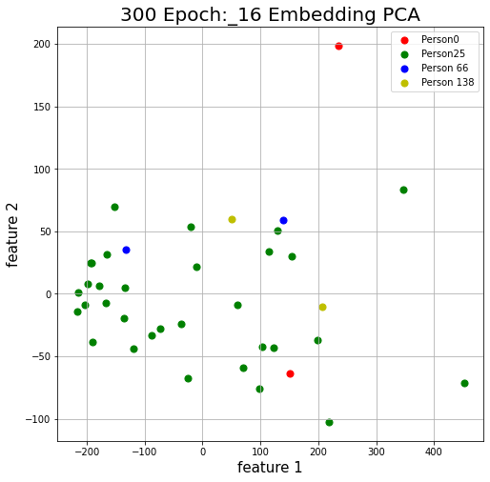
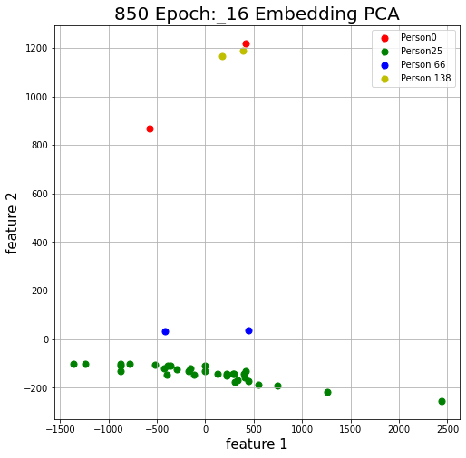
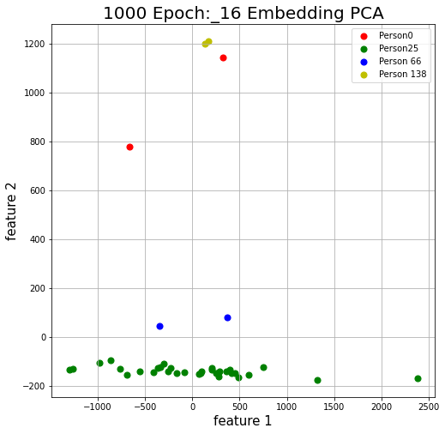
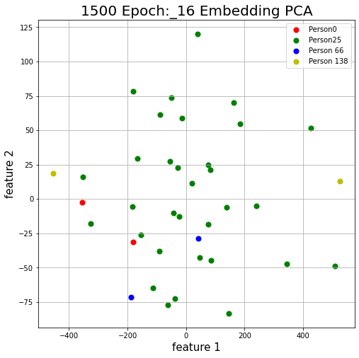
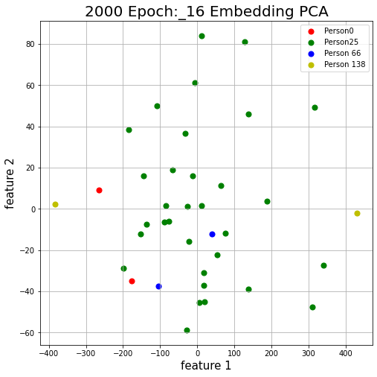
Performance as Epochs Progress
Cos Method, SGD, 16 dimensional embeddings

Slide 15
Best Model in Our Arsenal: arccos, Adam, 16 dim embedding, 800 epoch model

Slide 16
Using The Model
Face Recognition
Face Verification
Calculating Threshold
Code

Slide 17
Deployment
Using Flask, JS and Ajax
Simple Interface
Demo

Slide 18
Project By
P. Balasubramanian
200050103
Mahesh Bhupathi
200260027
Yash Mailapalli
200050160
Thank You

